Slide 1
Synchronising to Broadcast Signals
Mike Ellis
mike.ellis@bbc.co.uk
I
T
S
F
International Timing and Sync Forum
November 2018

Slide 2
Synchronising to Broadcast Signals
The germ of an idea…
What have we got already?
Challenges
Solutions…?
What on earth is going on?

Slide 3
What on earth is going on?
“Ghost” satellites created by receivers
Resulted in random timing jumps in some receivers
Caused by GPS satellite transmit power increase
January 26th, 2016
GPS SVN 23 event
Multiple 13µs timing jumps from many GPS/GNSS receivers
January 26th, 2017 – exactly a year later
April 6th - preparing for WNRO#2
GPS Week Number Roll Over
Can we trust the receivers to get this right?

Slide 4
Synchronising to Broadcast Signals
The germ of an idea…
What have we got already?
Challenges
Solutions…?
What on earth is going on?

Slide 5
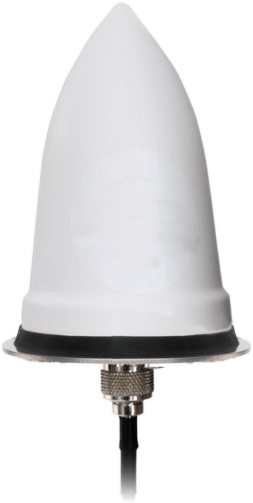
The germ of an idea
January 26th 2016
Notes:
We started thinking – we (the BBC) need a way to get accurate timing to lots of remote and not-so-remote locations.
Typically we have used GPS for this
But as well all know, no single system comes with 100% guarantees
So we have local clocks to allow us to handle short duration failures
The January 2016 event was different though – because the fault wasn’t at the receive end, it was in the constellation itself – so what we really need is a backup time source
Fortunately we have GLONASS – except that with two clocks, you still don’t know which one is right when they differ.
Of course there is (/soon will be) a third – Galileo.
So we’re sorted, right?
Well, we probably are for constellation errors, but we also need to deal with problems closer to home. White Van Man with a GNSS jammer or, worse, spoofer. Most GNSS solutions can be attacked in the same way, using the same frequency band. We need something different.
How about something which isn’t space-based? Something terrestrial…
Do we work with any companies who run large terrestrial transmitter networks…?

Slide 6
Scope of the question
Scope
How can we use the signals the BBC already broadcasts to deliver accurate timing fit for the BBC’s purposes?
Key criteria
Economic to deploy to hundreds of locations
Microsecond level accuracy
Receivers able to recover after a cold-start fully autonomously within a few minutes
Wholly under BBC (or UK) control
Supplementary scope
Do other industry sectors have compatible requirements?
Cover at least the mainland UK land-mass
Receiver locations can be surveyed and are static

Slide 7
Synchronising to Broadcast Signals
The germ of an idea…
What have we got already?
Challenges
Solutions…?
What on earth is going on?

Slide 8
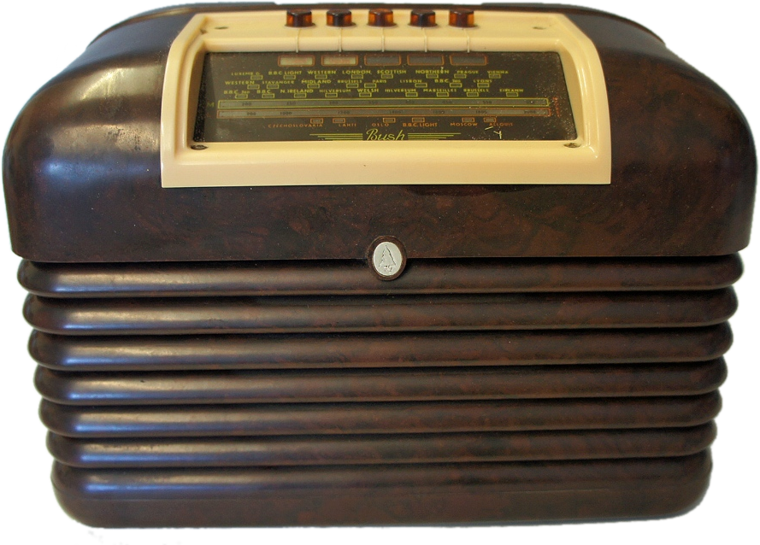
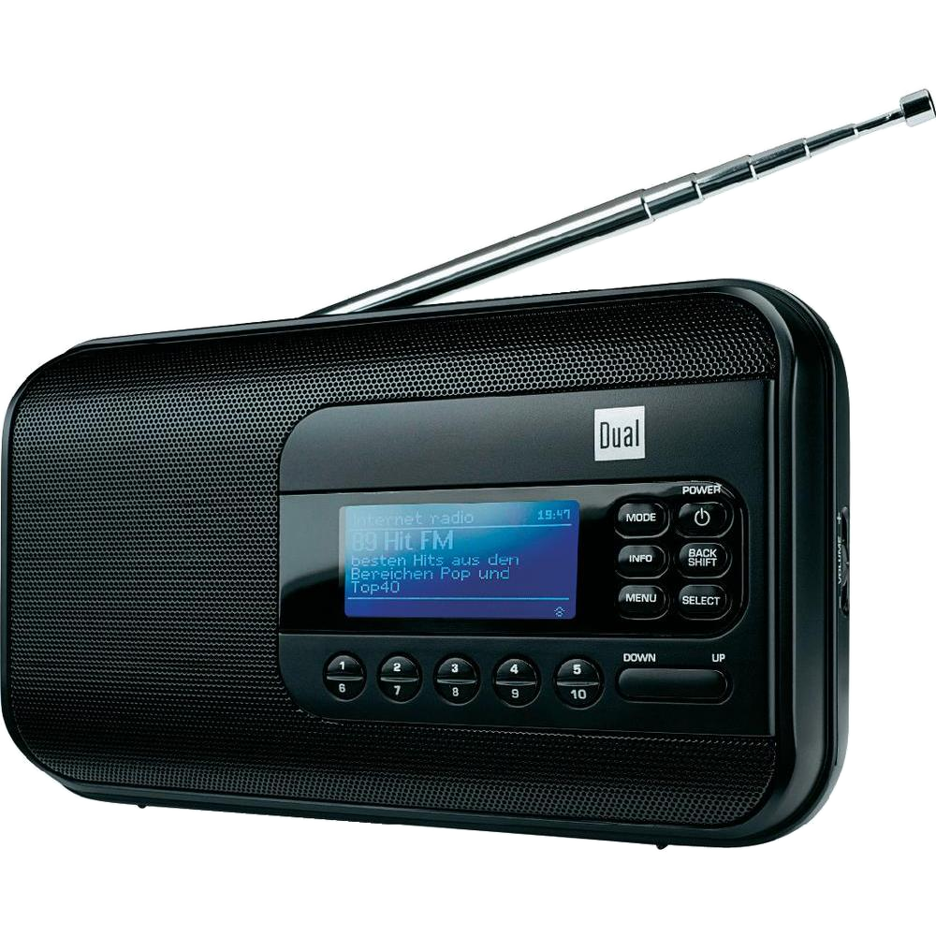
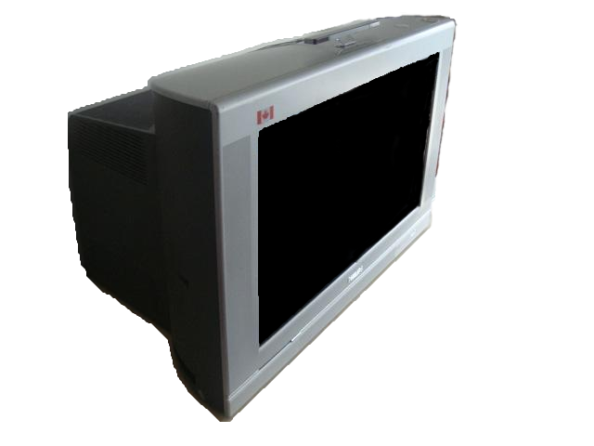
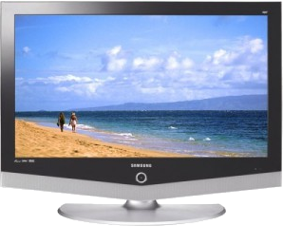
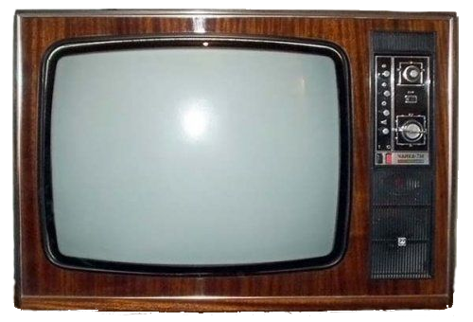
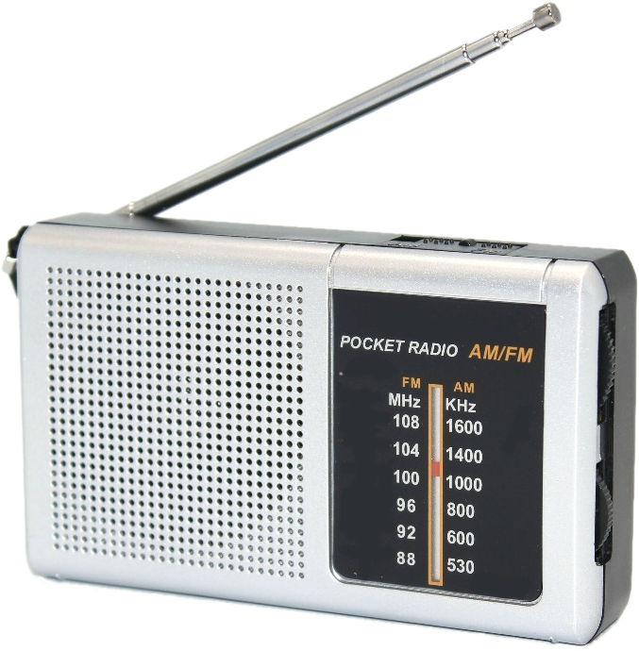
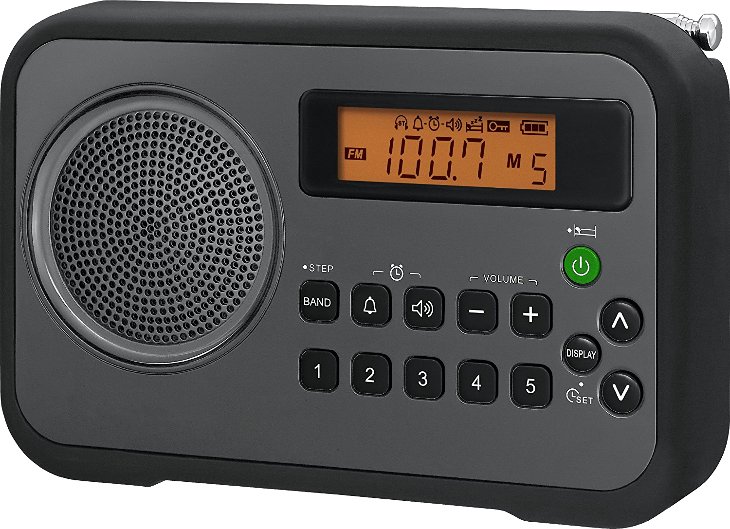
Useful BBC timing sources
Frequency
Service area
Timing
Notes:
So what services do we broadcast, and what characteristics do they have for distributing timing and/or frequency?
Starting back in 1922, we have ran AM radio services. These generally have relatively basic frequency control and no timing data.
From the 1940’s, analogue monochrome TV had good frequency stability.
Starting in the 1960’s, we added FM – only slightly better than AM.
Toward the end of the 1960’s, colour television came along – slightly better than monochrome.
In the 1970’s, the addition of RDS and teletext/Ceefax gave us some timing information!
In the 1990’s we started Digital Radio services. Much better frequency stability, and some timing
Digital TV is pretty much the same as Digital Radio.
We’ve forgotten about longwave! In the UK it has already got a precise frequency reference…
…and in the 1980s we added a data service carrying date and time information
So what about the future? Well, analogue television has already gone in the UK
The audience of AM radio is steadily declining, and it is the worst timing/frequency reference anyway, so that leaves us with four viable options. Let’s see how large an area each transmitter covers, taking FM as a “given” with an “average” service area per transmitter.
By comparison to FM, the service area for a DTT transmitter is quite small and needs external, directional antennas.
DAB is operated as an SFN to cover the entire country, but each individual transmitter only serves a small area. Also, using an SFN as a timing distribution system is potentially fraught with chicken-and-egg problems.
Which leaves as with longwave. Longwave has a huge service area from a single transmitter – almost the entire UK…
…and recent work undertaken by BBC R&D suggests that we can extract timing data from longwave with potentially microsecond level accuracy for fixed/known location receivers

Slide 9
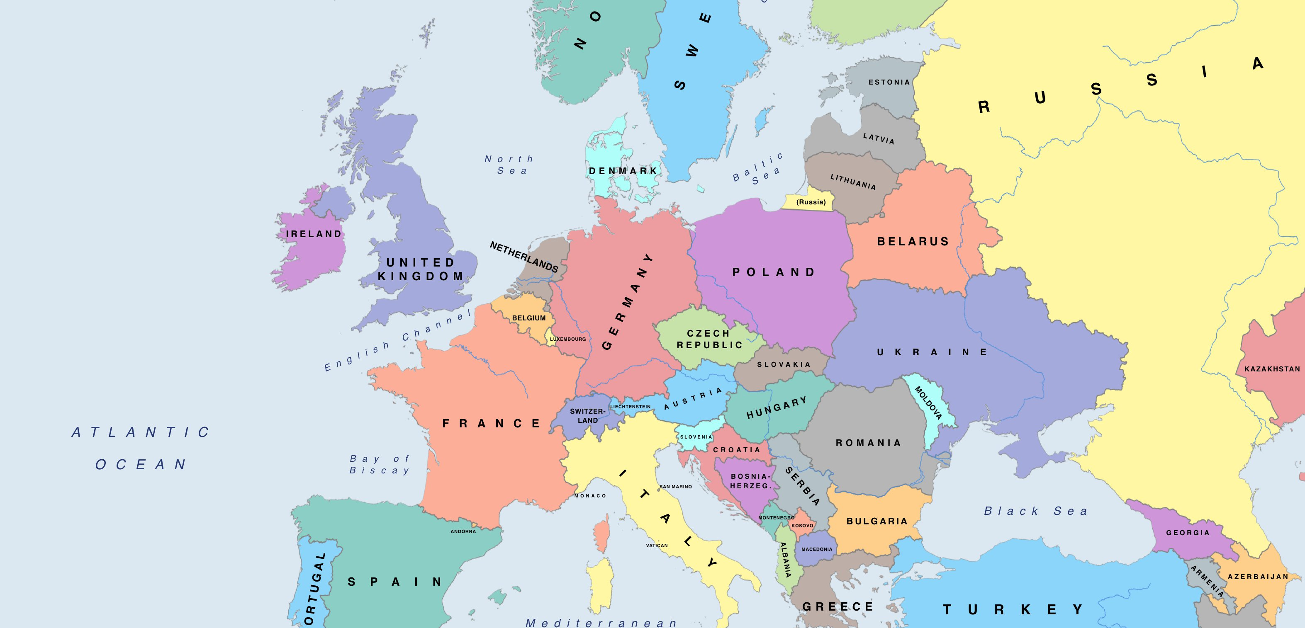
Longwave service coverage
Notes:
So why is Longwave such a good choice? Where would such a service be usable?
There are a number of existing Longwave time-only services, such as MSF broadcast on 60kHz from Anthorn in the UK
There is DCF broadcast on 77kHz from Mainflingen in Germany
There is the less well known TDF timing service broadcast on 162kHz from Allouis in France – this was scheduled to be turned off around 2016, but has had a stay of execution because a large number of users relied upon it, however the future is still not assured.
Then we have the BBC Longwave services, broadcast in 198kHz from Droitwich in the UK. This is primarily an audio service, however…
…we believe that a pure timing service could have a much larger coverage area if we so chose, although probably not as large as the service from Allouis.

Slide 10
Synchronising to Broadcast Signals
The germ of an idea…
What have we got already?
Challenges
Solutions…?
What on earth is going on?

Slide 11
Time Transfer Fundamentals
The Speed of Light
1ms per 300km
1µs per 300m
Notes:
In the real world, how do we build a system to deliver time accurately?
Well, we have to start with a clock
We also need a receiver… and that receiver needs to be a bit special
We also need a transmitter
Then we need to get time to the transmitter, and send it to the receiver
We’ve got a clock, and we’ve built a receiver – so that’s two big parts ticked off
Our transmitter is quite old, so we do need to do some work on it
But, that’s not the only problem. Every silver lining has a cloud… and wet weather can change the ground conductivity, changing how long the signals take to get from the transmitter to the receiver.
We also need to consider space… Space bends radio waves, so the receiver will see both the ground wave and a skywave from the transmitter
Both the ground wave and the sky wave actually vary over time, with the weather, with the seasons, and with solar flares. In fact, the radio path is a bit more of a wibbly wobbly timey wimey thing. Can we measure it enough to compensate for these effects? We think so, but this is an area of active research at the moment.
We also know that with a single transmitter, the receive will need to be surveyed accurately to compensate for the fact that the speed of light is too slow. We are NOT doing active research on inventing the warp drive!
We also have concerns about the link from the clock to the transmitter – it’s a bit wibbly wobbly too.
So we want to move the clock closer to the transmitter, to eliminate this source of error.

Slide 12
Technical questions to be answered
What time?
UTC or TAI?
What date?
Day/ Month/ Year
What else?
What path?
Tropospheric correction?
Ground conductivity correction?
Encryption?
What have we forgotten?
Leap seconds?
Daylight saving?
(Modified) Julian Date?
Leap years?
Planned maintenance?
Assurance?

Slide 13
Commercial and Political questions to be answered
Lifetime
A few years?
Cost
How much?
Users
Government?
Open to all?
Fee for higher accuracy?
Fee for assurance?
Operator
BBC, Arqiva, NPL, …?
Monitoring?
Traceability?
A couple of decades?
Indefinite?
Users?

Slide 14
Synchronising to Broadcast Signals
The germ of an idea…
What have we got already?
Challenges
Solutions…?
What on earth is going on?

Slide 15
Have we got a solution…?
Fixed location receivers within the UK ✓
Global coverage ✗
Approximately microsecond accuracy ✓
Mobile receivers ✗
Location / Navigation services ✗
Independent of GNSS ✓
If we do a lot more work…!

Slide 16
Synchronising to Broadcast Signals
Mike Ellis
mike.ellis@bbc.co.uk
I
T
S
F
International Timing and Sync Forum
November 2018

